Slide 1
Netflix Content Based Recommendation System
Gowreesh Gunupati, Sarthak Kagliwal, Harshal Shinoy Thachapully

Slide 2
Introduction
What are Content-Based Recommendation Systems?
Personalization based on user's past interactions
Focus on item features and content
Examples: Movie recommendations based on genre, book recommendations based on author
Our project is based on building a recommendation system for recommending movies similar to the users taste. To build and test our model, we have used a Netflix Movie and TV shows dataset.

Slide 3
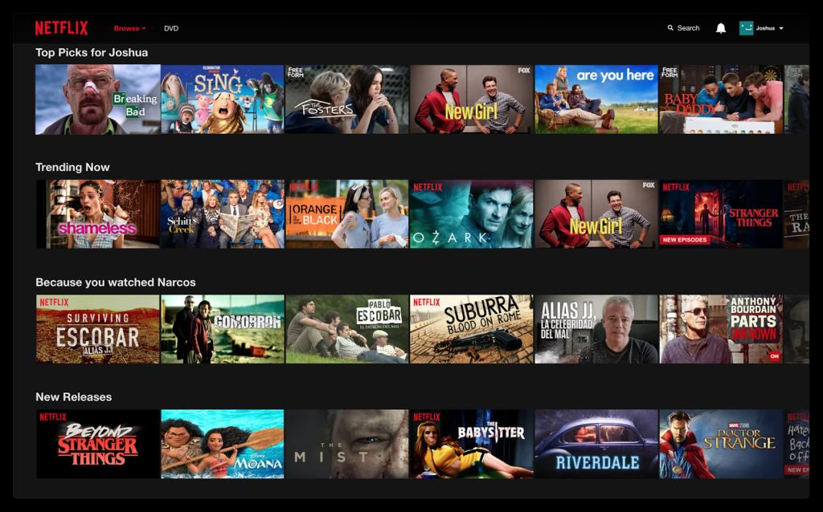
Importance of recommendation System for Netflix
Enhanced User Experience: Personalized recommendations help users discover content they'll enjoy from Netflix's vast library, making their viewing experience more enjoyable and efficient.
Increased Engagement and Retention: Accurate recommendations lead to longer user engagement and higher subscriber retention rates, which are essential for Netflix's continued success.
Revenue Growth: By driving content consumption and attracting more subscribers, recommendation systems contribute significantly to Netflix's revenue growth in a competitive streaming market.

Slide 4
Netflix Dataset
Vast Content Library: The dataset reflects Netflix's extensive content library, featuring over 8000 movies and TV shows. This highlights the platform's commitment to providing a wide range of entertainment options to cater to diverse audience preferences.
Global Reach: With a subscriber base of over 200 million globally as of mid-2021, Netflix's dataset underscores its massive international presence. This indicates the platform's ability to offer content that resonates with a global audience and its potential as a data source for analyzing viewing trends worldwide.
Rich Metadata: The dataset contains comprehensive metadata about the movies and TV shows, including information on cast, directors, ratings, release year, duration, and more. This rich metadata can be invaluable for various analytical purposes, such as content recommendation algorithms, trend analysis, and understanding viewer preferences.

Slide 5
Data Preprocessing
Rating Correction: Misclassified 'rating' values, such as '74 min', are corrected to appropriate ratings like 'TV-MA' to ensure data consistency.
Filling Missing Countries: Missing 'country' values are filled with the most common country in the dataset, ensuring complete country data for all titles.
Specific Rating Updates: Corrects specific incorrect 'rating' entries for certain records, ensuring accuracy in the dataset.
Rating Standardization: Similar rating categories are standardized (e.g., 'TV-G' to 'G'), simplifying the rating system for better analysis.
Maturity Level Assignment & Content Aggregation**: Titles are categorized into maturity levels ('kid', 'teen', 'adult') based on ratings, and a 'content' column is created by combining key features into a single string, providing a comprehensive content profile for each title.

Slide 6
Exploratory Data Analysis
Missing Data Management: Addressed missing values, especially in the 'country' field, enhancing data integrity.
Recent Content Trend: Noted a significant number of recently released or added movies and shows, indicating a constantly updated content library.
Balanced Demographic Content: Observed a similar distribution of content across teen, adult, and kids categories, reflecting a diverse content strategy.
Duration Insights: Analyzed content duration, crucial for understanding viewer preferences related to the length of movies and shows.

Slide 7
Models Used
Vectorization (converting features into numerical representations)
Bags Of Words
Tf-IDF Vectorizer
Neural Network
Word2Vec

Slide 8
Similarity Measures
Pearson Correlation Coefficient: It measures the linear correlation between two variables and is commonly used in recommendation systems.
Cosine Similarity: It measures the cosine of the angle between two vectors and is widely used in recommendation systems due to its ability to handle sparse data.
Jaccard Similarity: It measures the similarity between two sets and is often used in recommendation systems for binary data.
Euclidean Distance: It measures the straight-line distance between two points in a multi-dimensional space and is often used in recommendation systems.
Manhattan Distance: It measures the absolute differences between two points in a multi-dimensional space and is often used in recommendation systems.

Slide 9
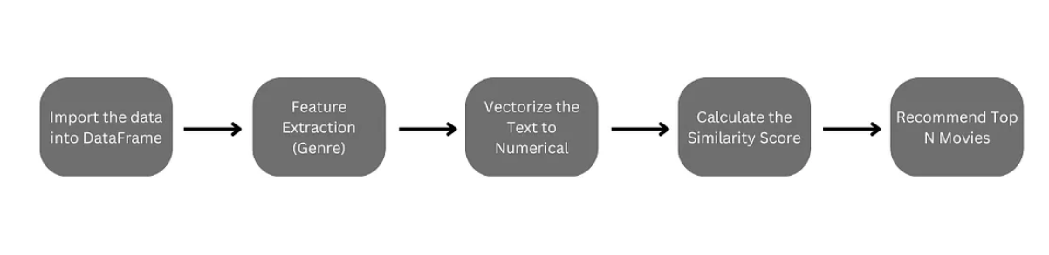
Project Pipeline

Slide 10
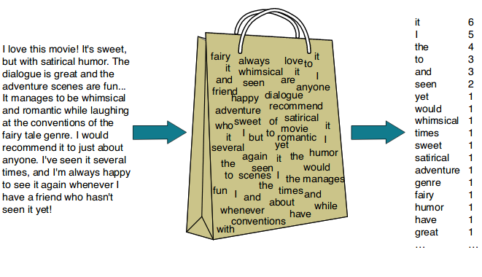
Bag of Words
Bag of Words is a simple vectorization technique that represents a document by counting the frequency of words.
Each unique word is treated as a "feature," and the resulting vector represents the content.

Slide 11
Bag of Words
Combine relevant features into a single string.
Create a Bag of Words using CountVectorizer.
Convert the Bag of Words to TF-IDF and apply Latent Semantic Analysis (LSA)
Ask the user for a movie title.
Find the index of the user movie.
Compute the cosine similarities between the user movie and all other movies.
Display the top 10 similar movies based on the Bag of Words model.

Slide 12
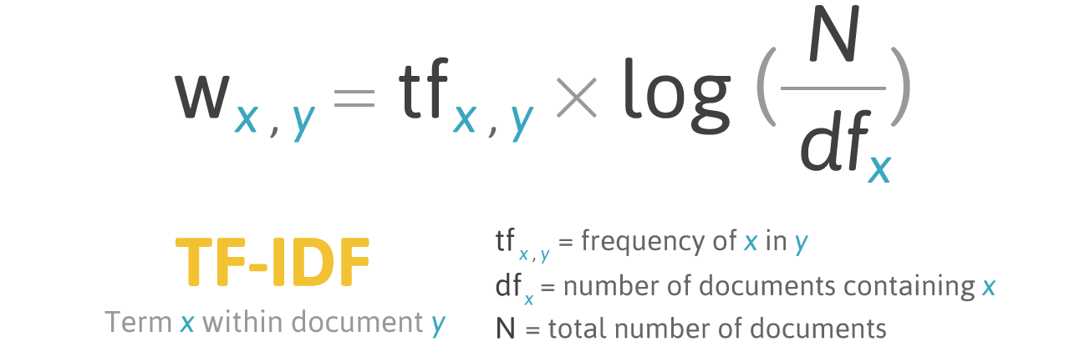
TFidfVectorizer
TF-IDF (Term Frequency-Inverse Document Frequency) assigns weights to words based on their importance in a document.
It helps address the issue of common words having high counts in Bag of Words.

Slide 13
TFidfVectorizer
Combine relevant features into a single string.
Create a TfidfVectorizer to transform the content into a TF-IDF representation.
Calculate the cosine similarity matrix between movies.
Ask the user for a movie they like.
Find the index of the movie in the similarity dataframe.
Display the top 10 most similar movies based on the TF-IDF model.

Slide 14
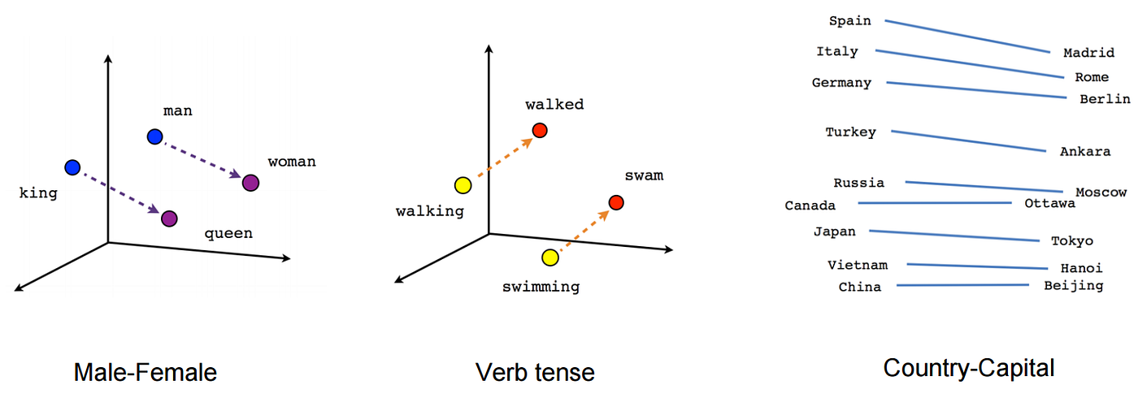
Word2Vec
Captures semantic meaning of words
Better than BoW and TF-IDF
Word2Vec model trained from scratch
Improved recommendation accuracy
Google News Word2Vec Model
300-dimensional vector space
Better performance compared to custom models

Slide 15
Word2Vec
Feature Composition:
Combine relevant movie features, including title, director, cast, country, rating, duration, listed_in, and description into a single string.
Tokenization:
Utilize the simple_preprocess method from the gensim library to tokenize the combined content, breaking it into individual words.
Word Embeddings:
Initialize a Word2Vec model with a vector size of 100, a window size of 5, a minimum word count of 1, and using 4 processing workers for efficiency.
Vocabulary Building:
Construct the vocabulary by building it with the tokenized content using the build_vocab method.

Slide 16
Word2Vec (contd)
Model Training:
Train the Word2Vec model on the tokenized content for a total of 10 epochs using the train method.
Vectorization Functions:
Implement two key functions:
average_word_vectors: Computes the average word vectors for a given text using the trained Word2Vec model.
averaged_word_vectorizer: Applies the average_word_vectors function to a collection of texts, returning a feature array.
Feature Extraction:
Apply the averaged_word_vectorizer to the entire corpus, resulting in a feature array representing the movies in a 100-dimensional space.

Slide 17
Limitations
Limited Personalization:
Content-based systems lack personalization as they focus solely on item characteristics, ignoring user preferences and behavior.
Impact: Results in suboptimal user experiences due to a lack of tailored recommendations.
Data Sparsity:
Content-based systems face challenges when dealing with limited data, especially for items or users.
Impact: The effectiveness of the system is compromised when there is insufficient information, hindering accurate recommendations.
Cold Start Problem:
Content-based systems struggle with the "cold start" problem when minimal or no user/item data is available.
Impact: Initial difficulty in making accurate recommendations, particularly for new users or items.

Slide 18
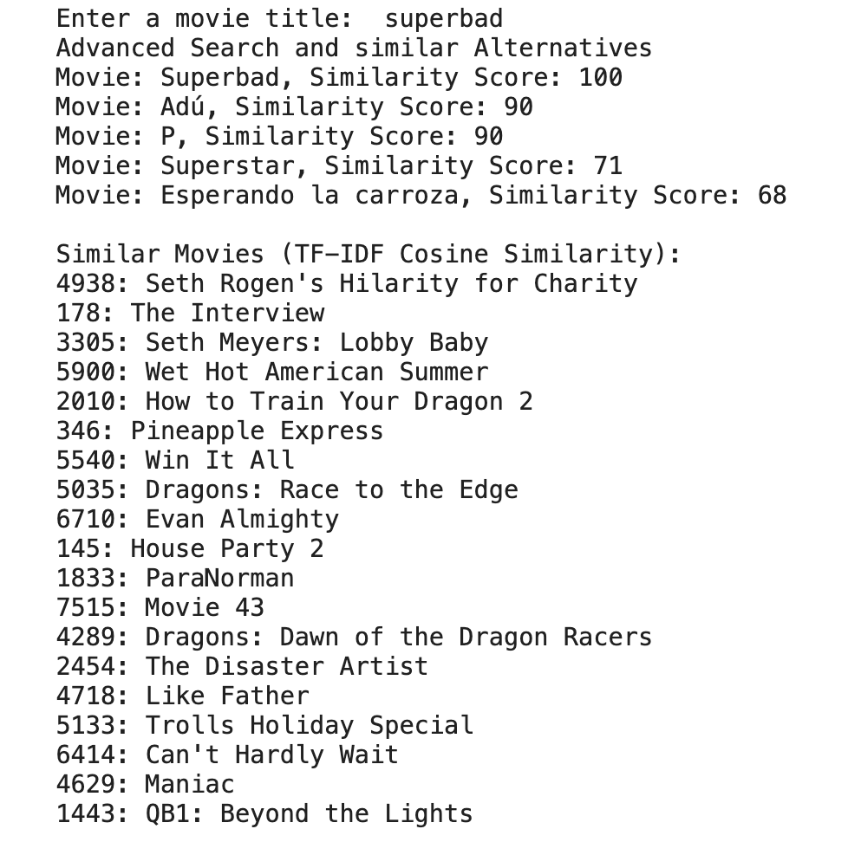
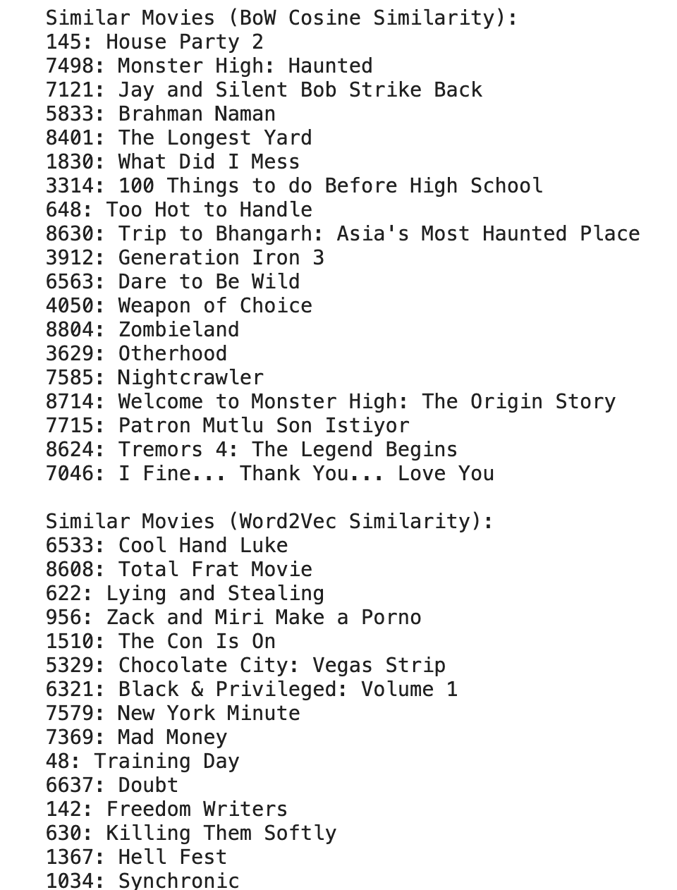
Experimentation

Slide 19
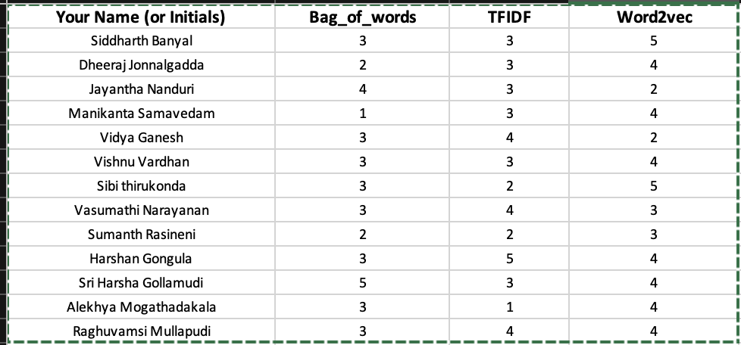
Results by Human Evaluation

Slide 20
Conclusion
Narrow Focus:
Content-based systems have a limited scope, focusing on a narrow set of features for recommendations.
Impact: Recommendations may lack diversity, missing opportunities for cross-selling or up-selling.
High Computational Complexity:
Content-based systems can be computationally intensive, demanding significant processing power.
Impact: Challenges in scalability, especially for large-scale systems or those requiring real-time recommendations.
Bias in the Data:
Content-based systems are vulnerable to biases present in the training data, influencing recommendations.
Impact: Recommendations may be skewed towards certain items or genres, perpetuating biases in the system.

Slide 21
Thank You - Questions?

